Slide 1
INFO 6150 Fall 2021 Green Kitchen
Qian Chen
Rongqi Sun
Jingru Xiang
Yalan Sun

Slide 2
Overview
Introduction
Features
Contributions
Implementation
Q & A
Image may be subject to copyright

Slide 3
What is Green Kitchen App
Green Kitchen is a “social media” for creating, sharing, and viewing customized salads and smoothie recipes made by users.
Since Covid-19, people are avoiding eating out, but tend to grab fast food or prepacked food more often, we are four college students who believe that every part of one’s well-being can be improved by proper nutrition. We created Green Kitchen app to make eating healthy easier, to lead people to reimagine fast food for a new era.
Healthy cooking could be simple and fun!

Slide 4
Features
It is a Full Stack Application
A simple recipe sharing application/web using React JS, JavaScript library and Bootstrap to make awesome UI, Node JS, Webpack, MongoDB.
Backend is implemented using Node JS, and MongoDB.
Frontend is implemented using React JS, Bootstrap components, JavaScript and SASS, CSS.

Slide 5
Contributions
Qian Chen: Skelton of website, Router, Combo Detail page, User comments Page
Rongqi Sun: Public combo view, User's combo view, Login, Register and Mongoose schema.
Jingru Xiang: New Plan Page, including ingredients and bowl design, interaction with MongoDB, page UI with Sass and Bootstrap
Yalan Sun: Home, About Us; map, footer, navbar etc.; compiled ingredients pictures; README.md, ppt slides and presentation.

Slide 6
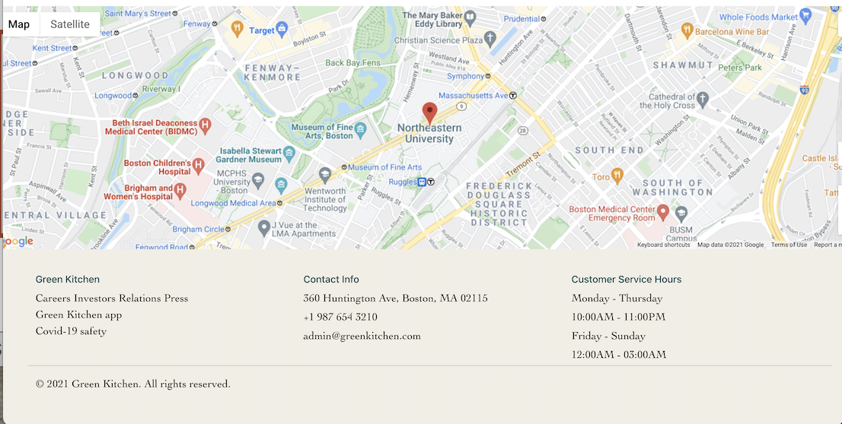
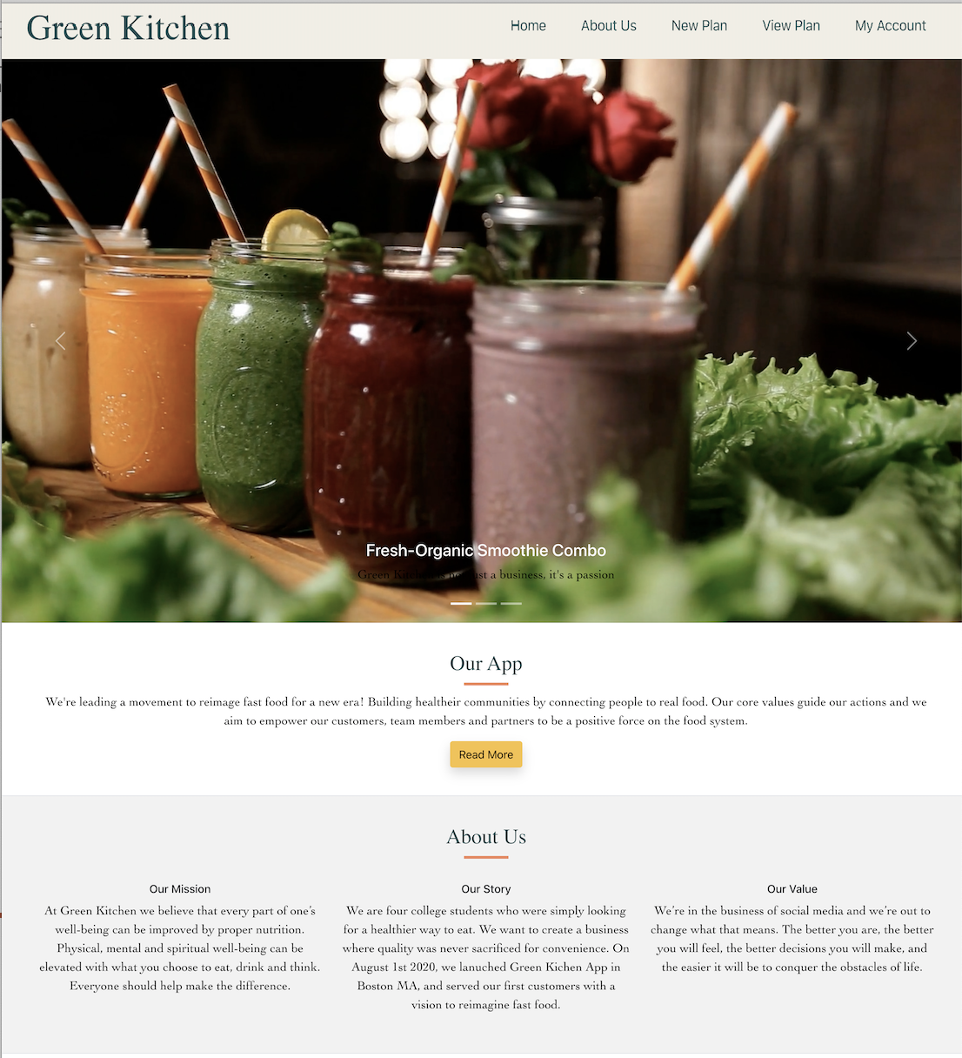
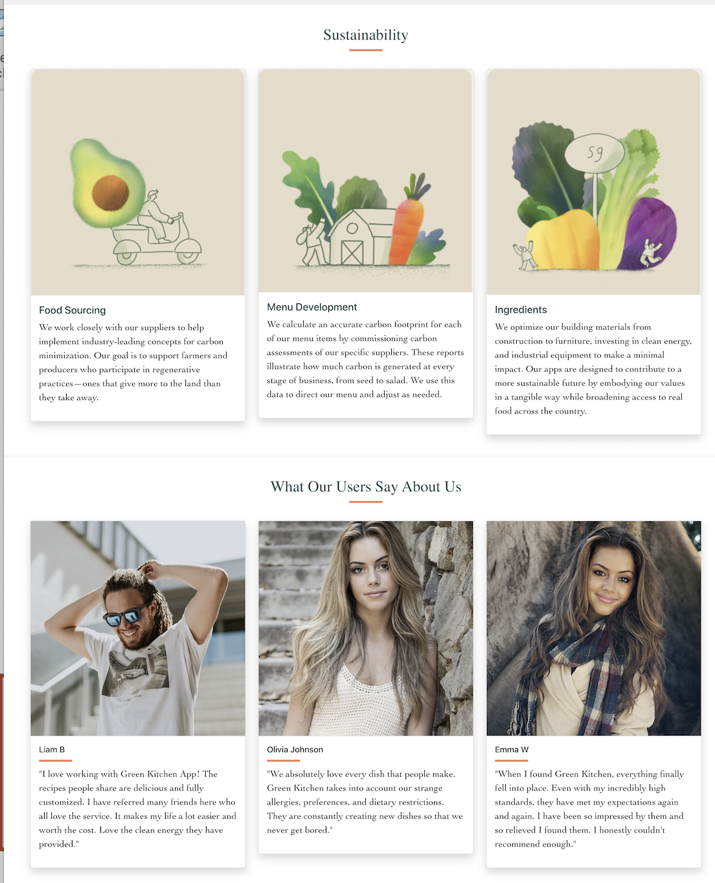
Home

Slide 7
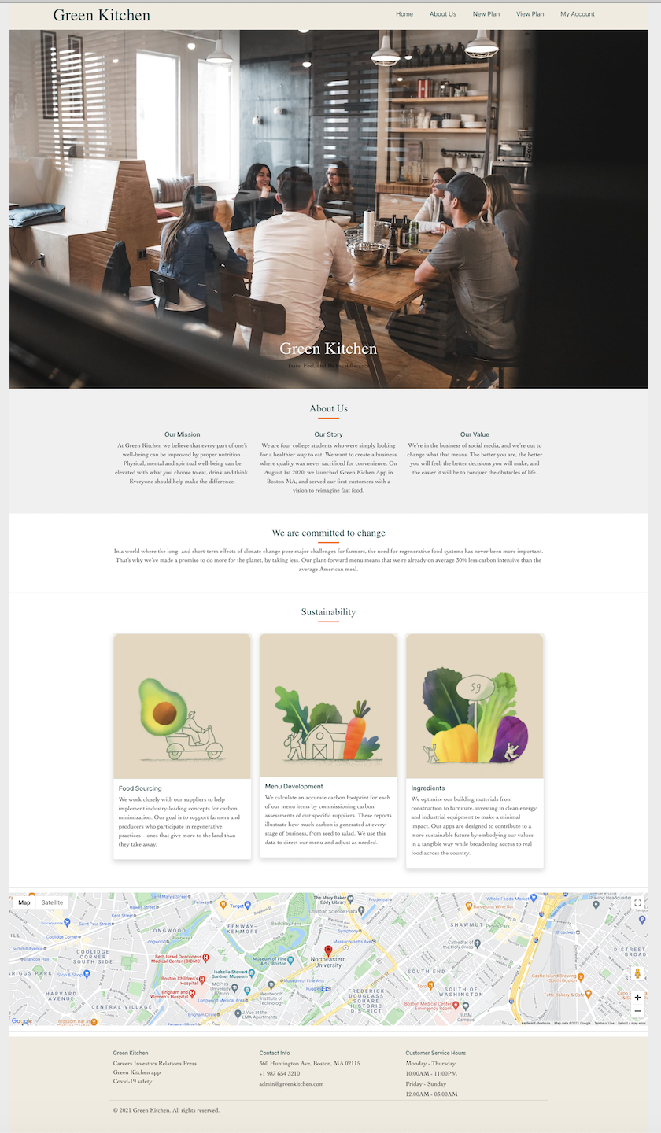
About Us

Slide 8
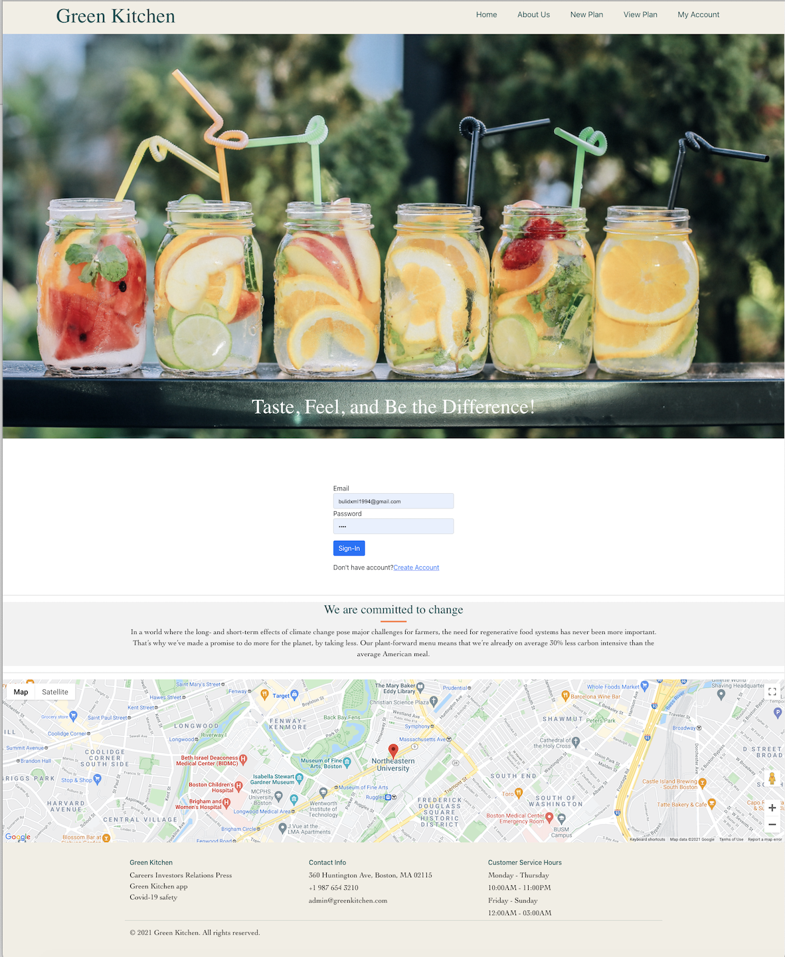
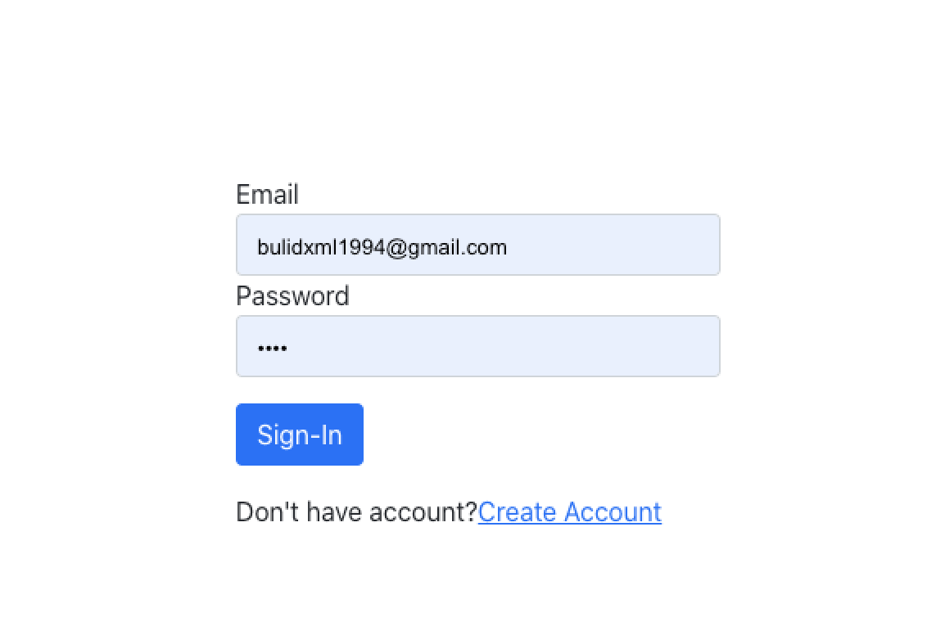
Sign In

Slide 9
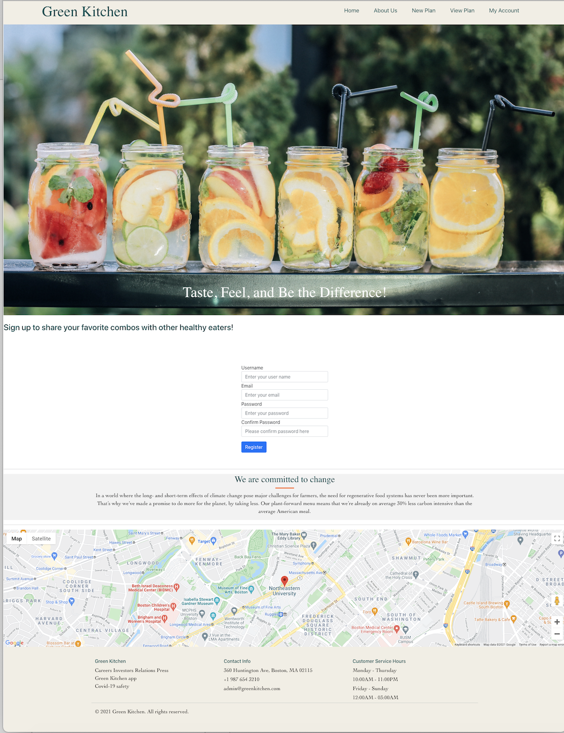
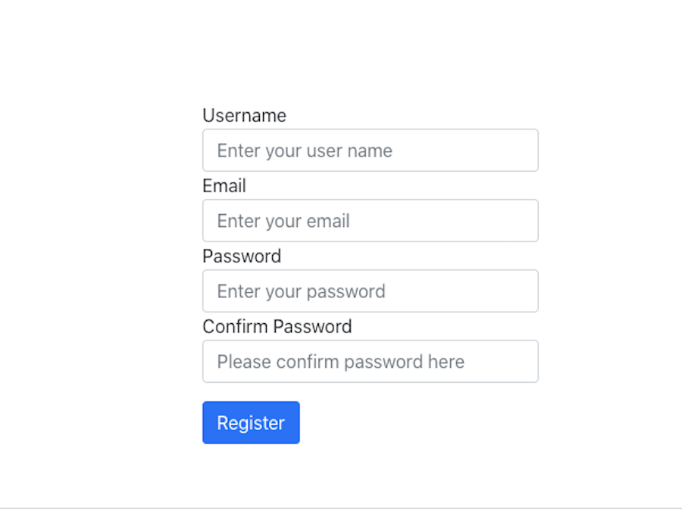
Create Account

Slide 10
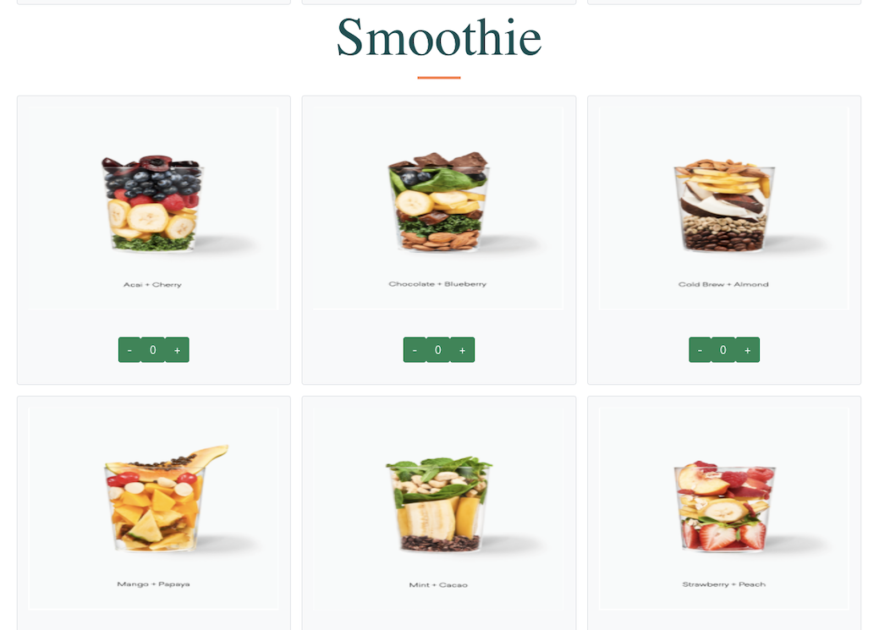
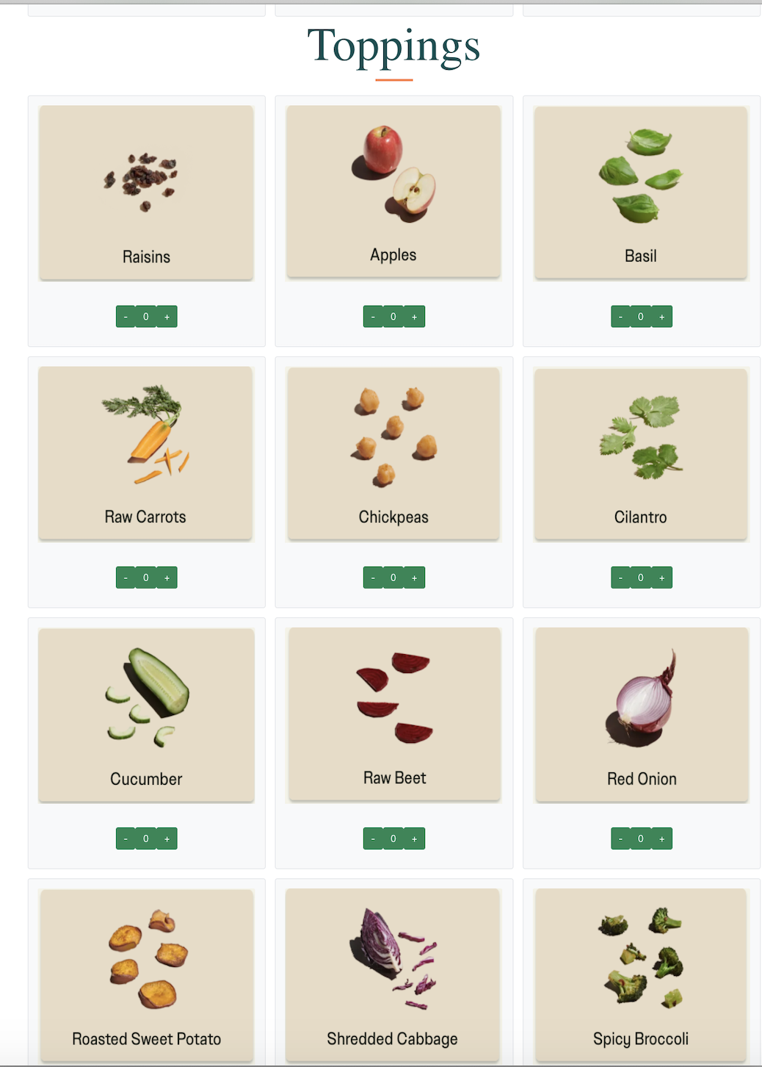
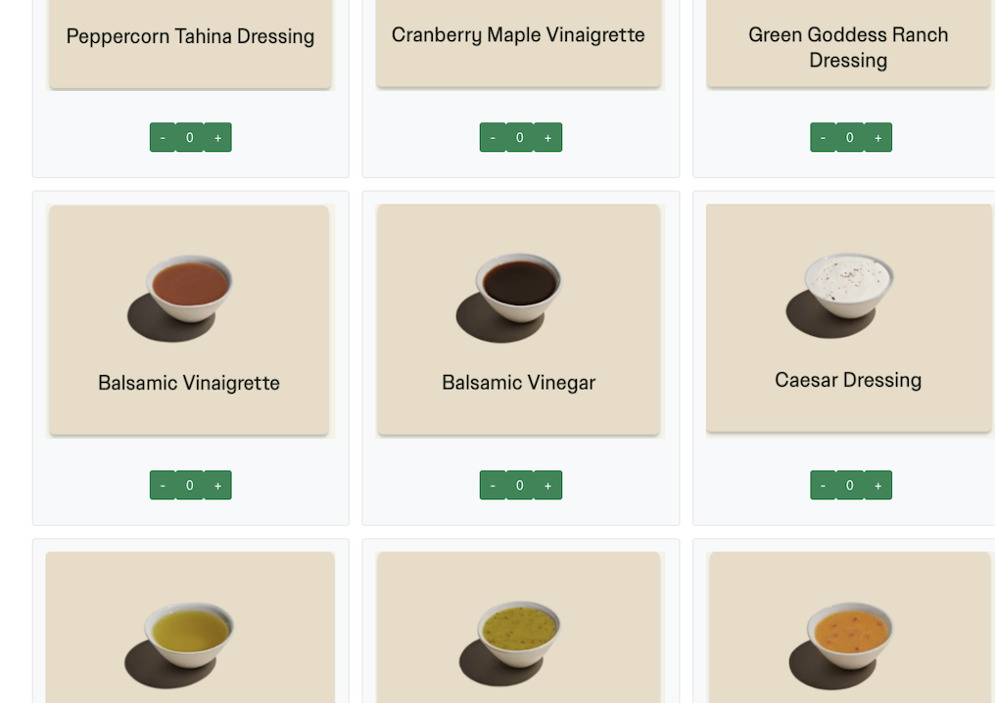
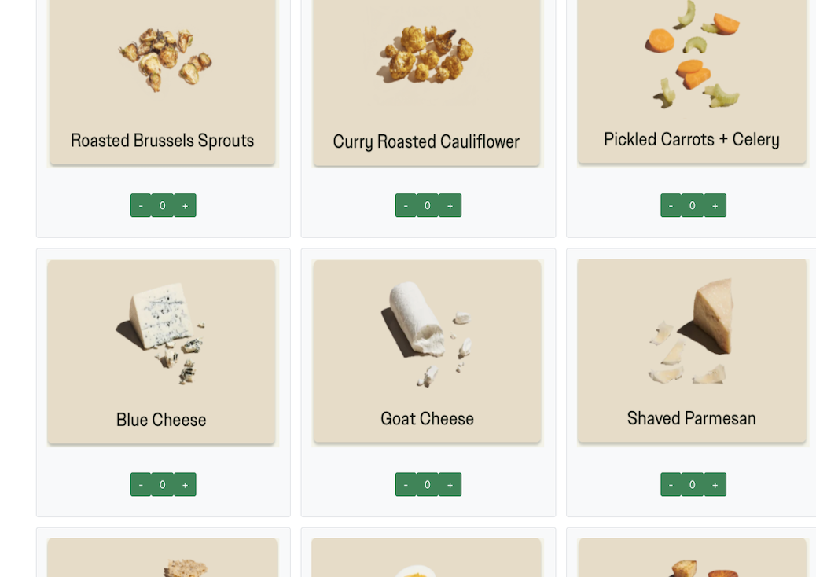
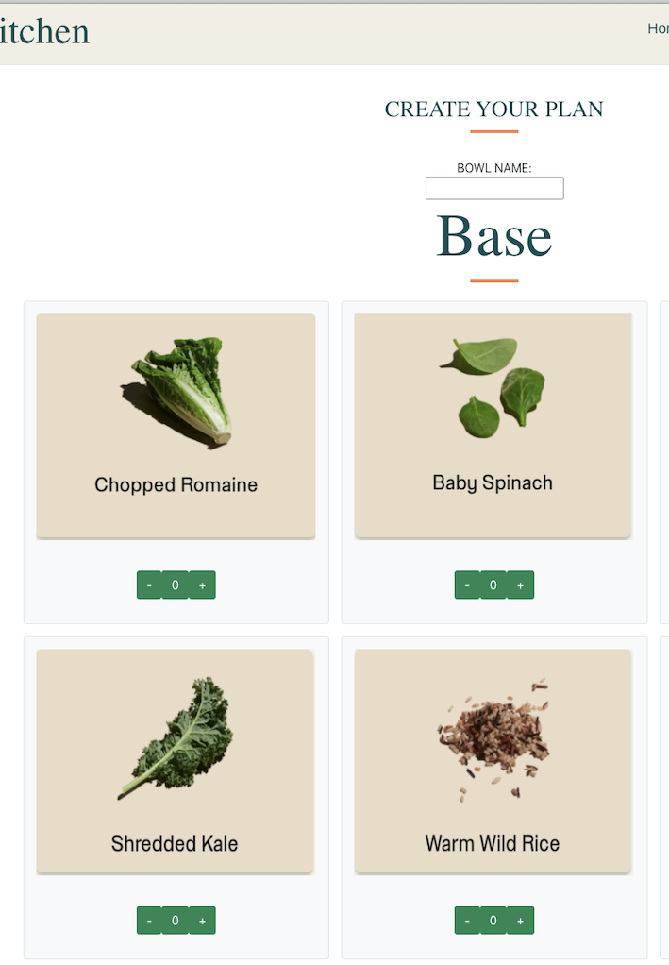
Create New Combo

Slide 11
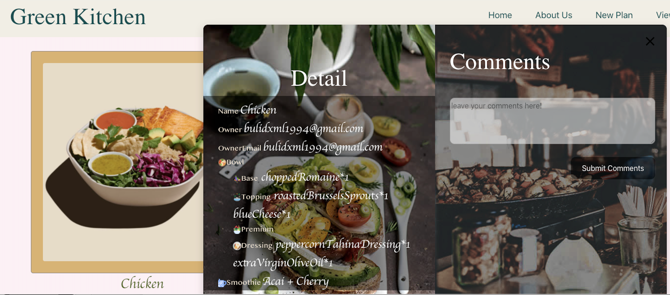
View Combo

Slide 12
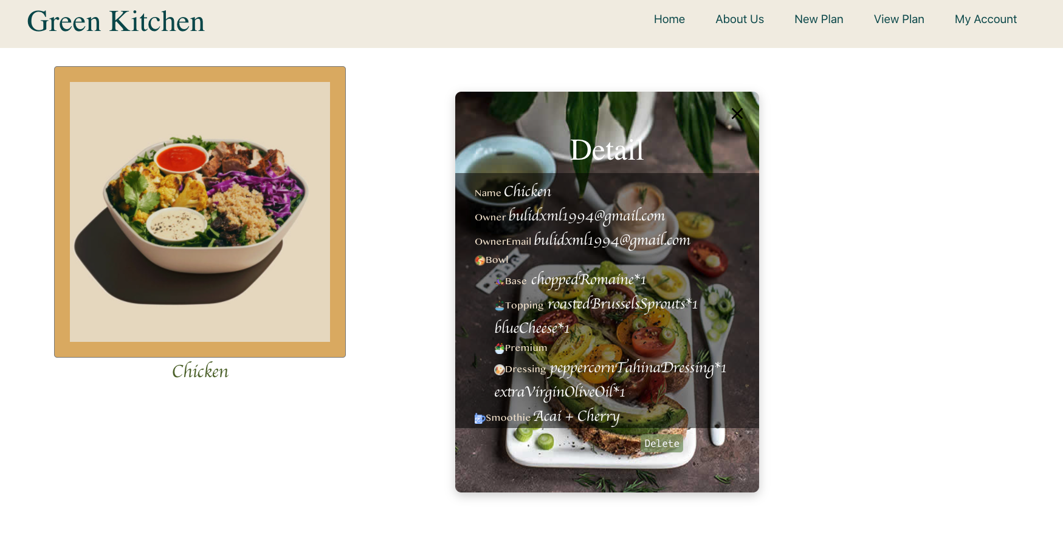
Update

Slide 13
Questions
Q&A

